Slide 1
Satellite Image Segmentation Prediction using Deep Learning

Slide 2
Introduction

Slide 3
Objective:
Develop a deep learning model for segmenting satellite images
Use different networks and architectures for accurate results

Slide 4
Importance of Satellite Imagery:
Urban Planning: Monitor city growth and infrastructure
Disaster Management: Assess damage from natural disaster
Environmental Monitoring: Track deforestation and climate patterns
Agriculture: Monitor crop health and optimize irrigation

Slide 5
Challenge of Manual Analysis:
Time-Consuming
Error-Prone
Not Scalable
Manual identification takes a lot of time
Human error can lead to inaccuracies
Impractical for massive datasets

Slide 6
Solution
Automated Segmentation with Deep Learning
Analyzing images and automatically identifying features

Slide 7
What we are using:
U-Net:Efficient for segmentation tasks.
Jaccard Coefficient: Metric for evaluating segmentation accuracy.
Loss Function: Dice loss and focal loss used for optimizing model performance.
One-Hot Encoding: Converts categorical labels into a format suitable for model training.

Slide 8
Libraries
Keras: Used to make the implementation of neural networks easy
-U segmentation Model: Library is a Python package designed for easy and quick implementation of image segmentation models
sklearn: Open-source library for machine learning,covering both supervised and unsupervised learning.
PIL: Python Imaging Library, is a powerful library for image processing in Python

Slide 9
Libraries
TensorFlow: Deep learning framework for building and training the U-Net model.
OpenCV: Library for image processing tasks.
Numpy: Library for numerical operations.
Gradio: Tool for creating interactive web interfaces for real-time model.

Slide 10
Dataset

Slide 11
Semantic Segmentation of Aerial Imagery
This dataset helps computers understand pictures taken from above, like from drones or satellites. It's like making a map where each tiny part of the picture gets a label, such as "building," "road," or "tree."
Link: https://www.kaggle.com/datasets/humansintheloop/semantic-segmentation-of-aerial-imagery

Slide 12
The dataset includes:
Aerial Images: High-quality images taken from drones or satellites.
Masks/Labels: Images where each pixel is labeled to show what type of land or structure it is.
Images: 72
Mask: 72
Dimensions: 509 x 544
Dataset Size: 31 M-btyles

Slide 13
Building | #3C1098
Land | #8429F6
Road: | #6EC1E4
Vegetation: | #FEDD3A
Water: | #E2A929
Unlabeled: | #9B9B9B

Slide 14
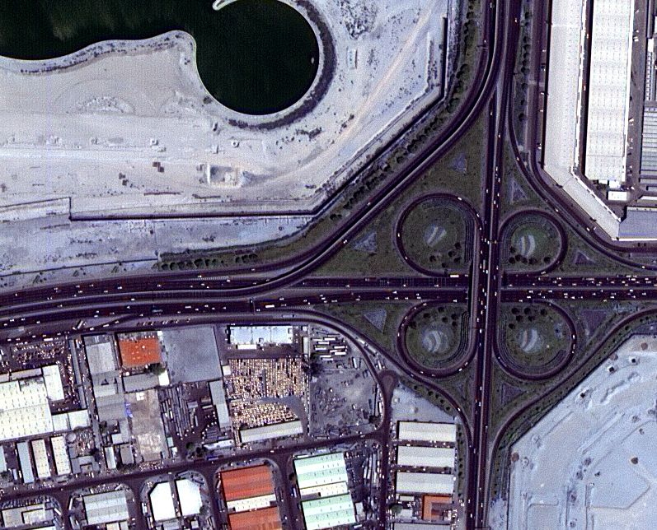
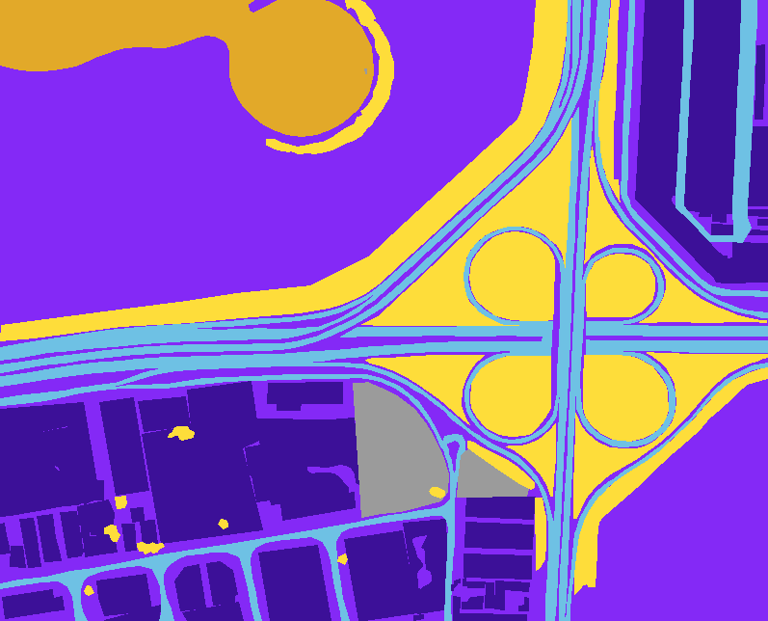

Slide 15
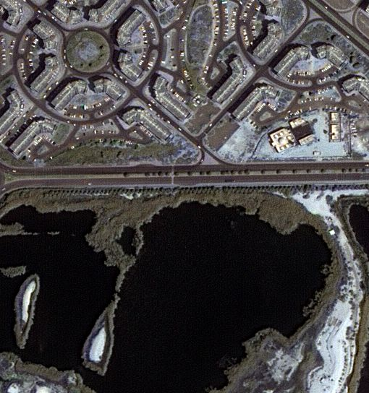
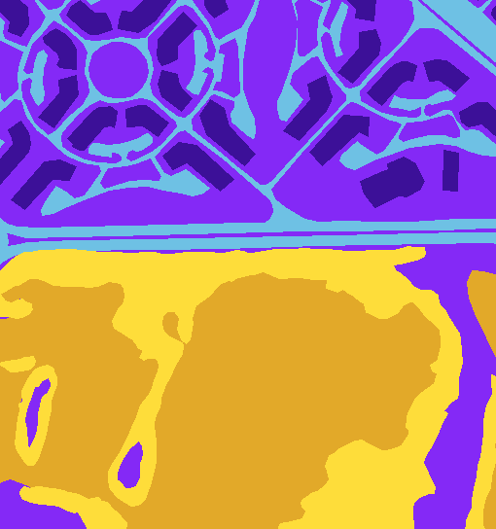

Slide 16
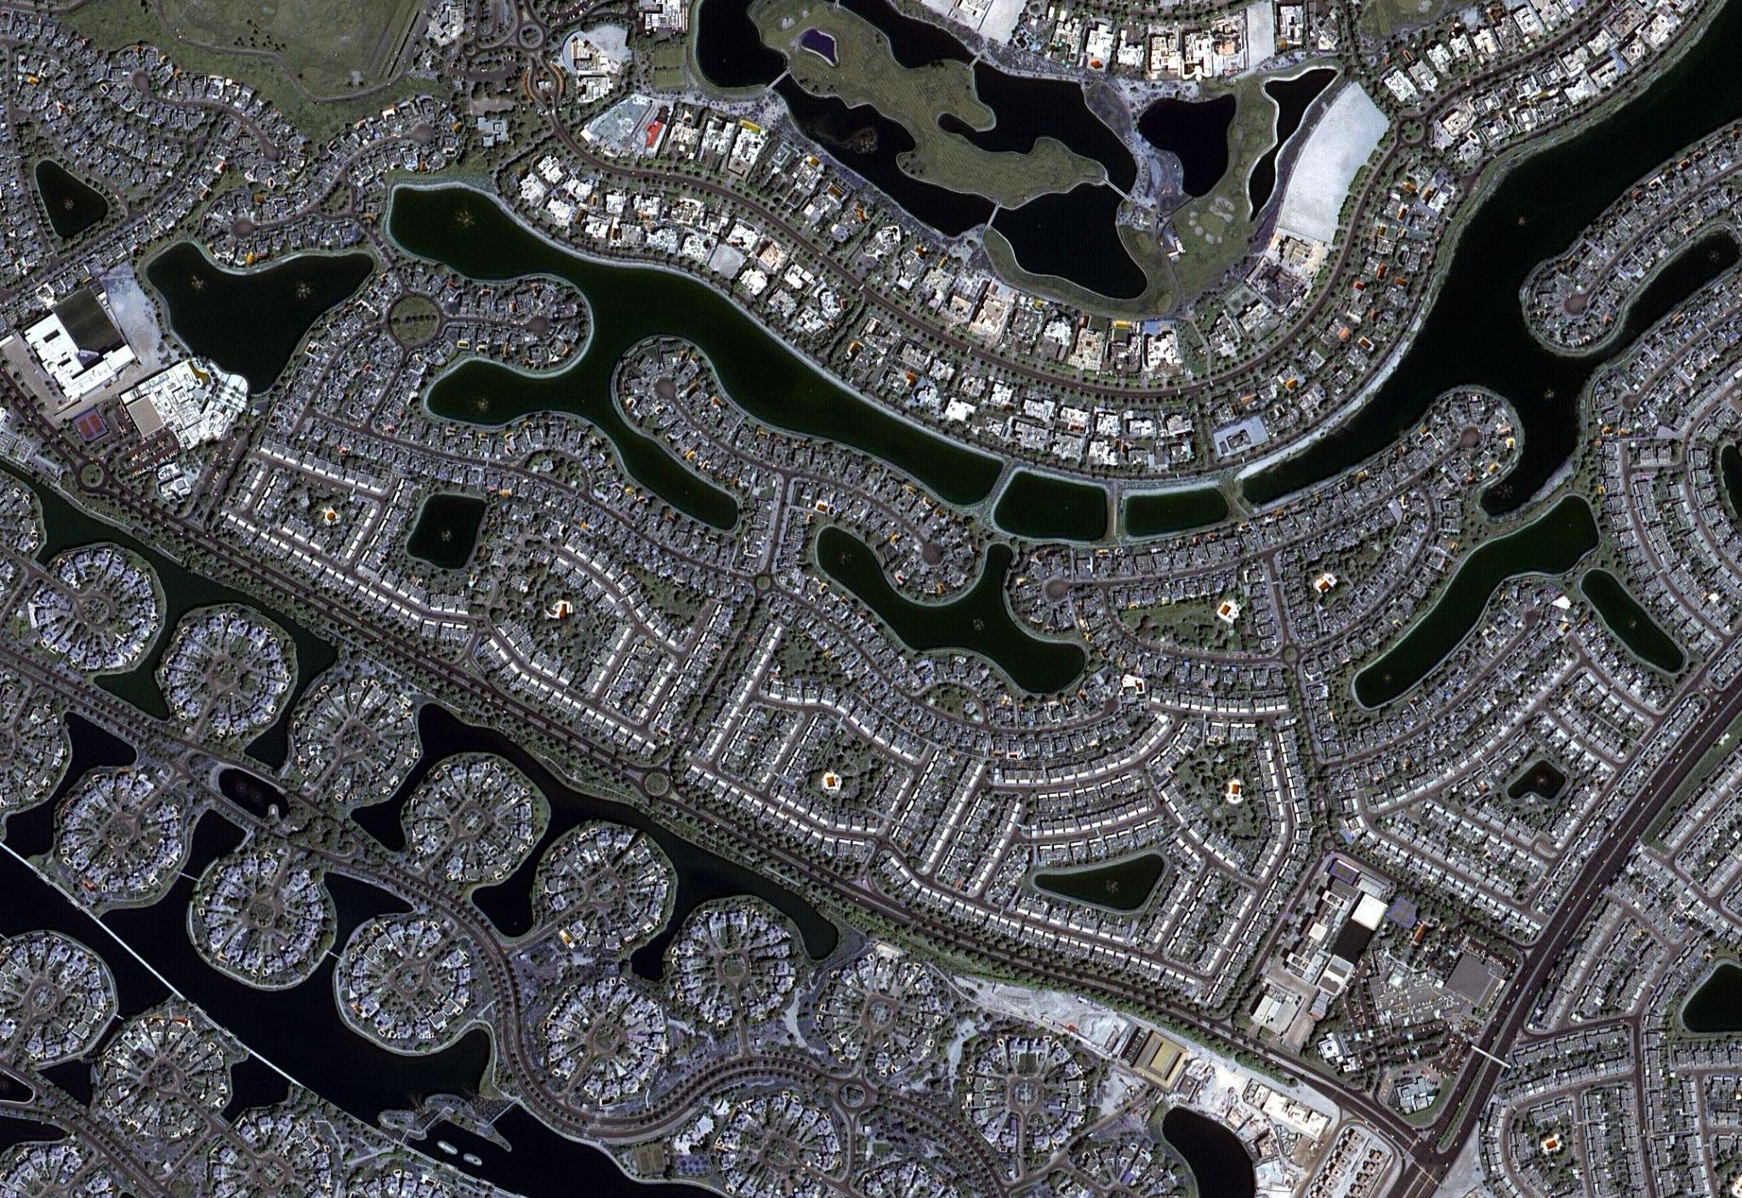
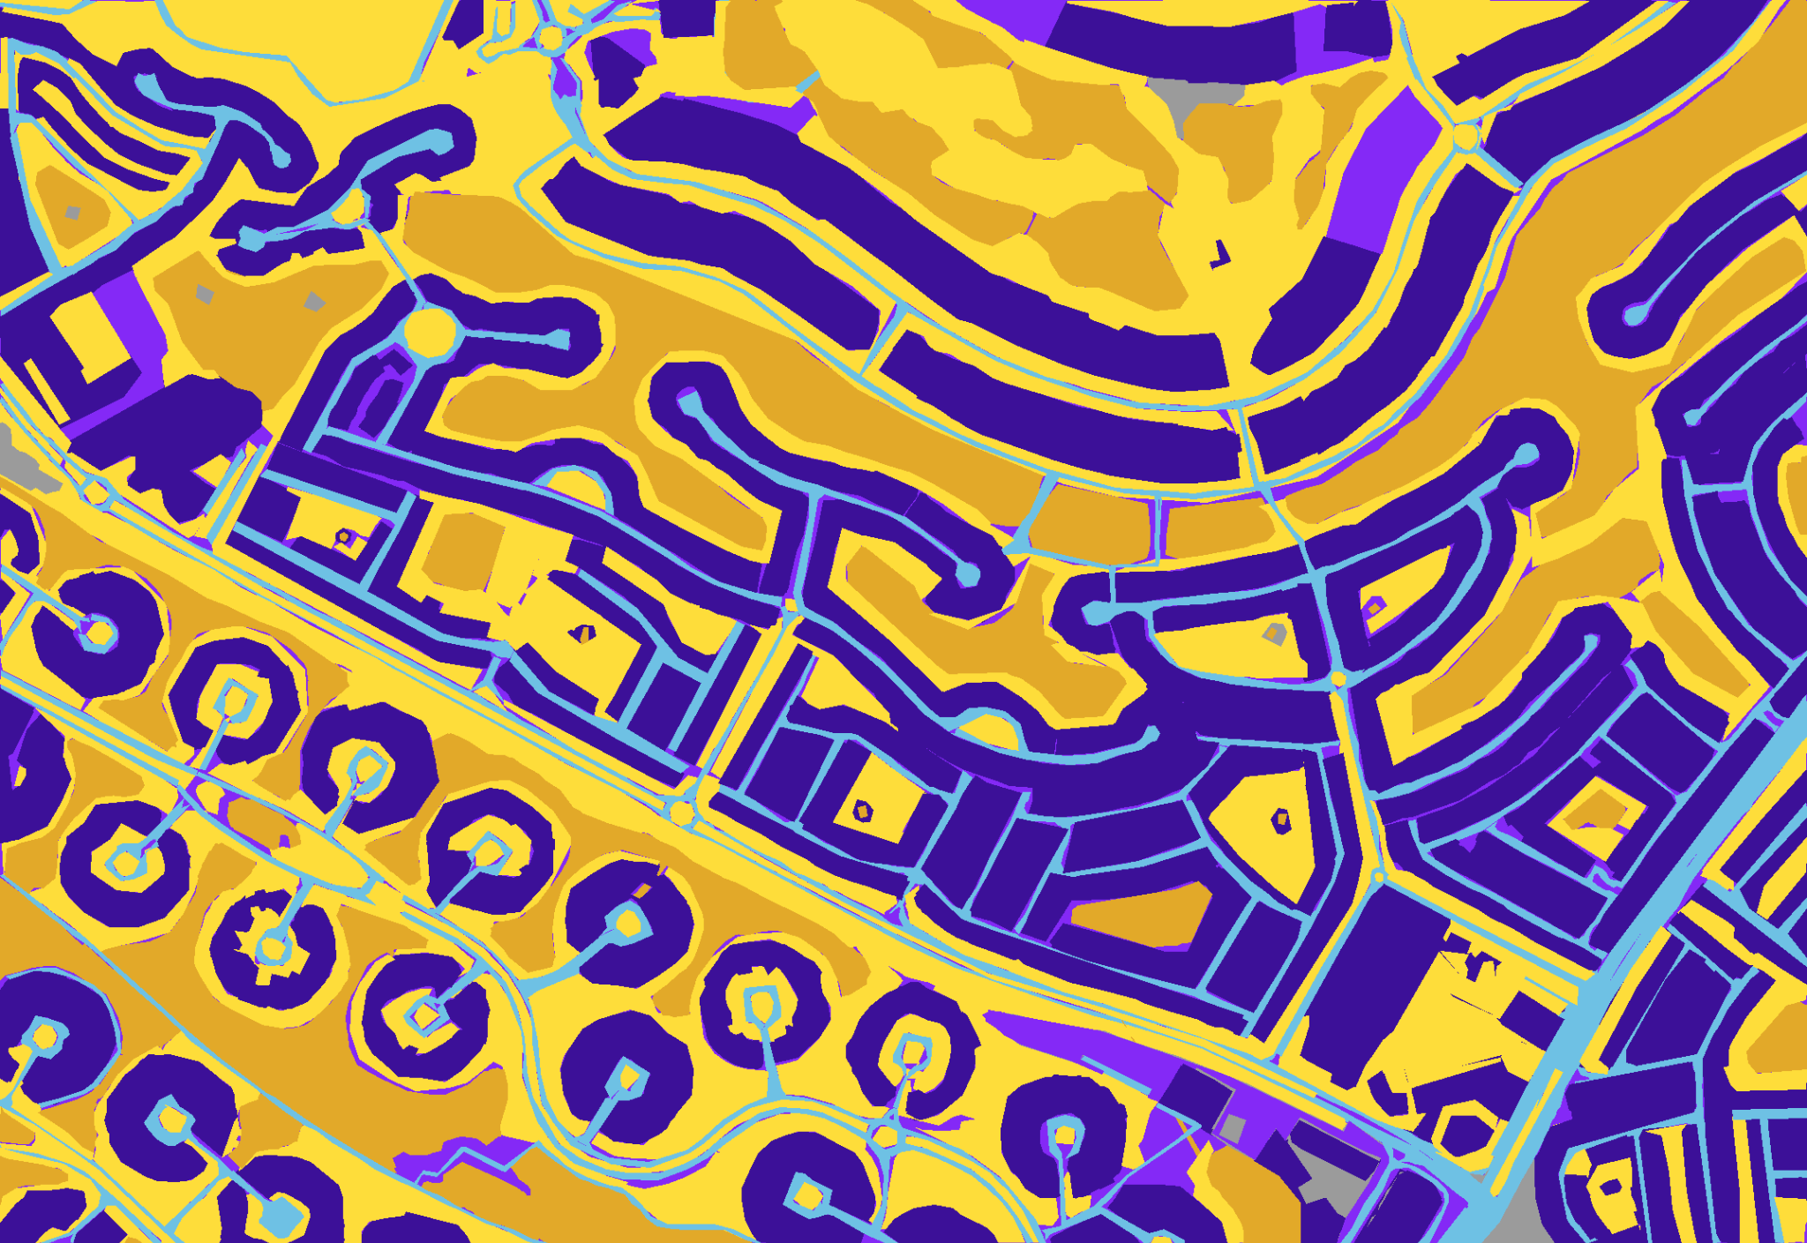

Slide 17

Importance:
It's important for tasks like city planning, monitoring the environment, managing disasters, and guiding self-driving vehicles.

Slide 18
Normalization

Slide 19
Before sending the image data to the model, it's essential to normalize the data to a range between 0 and 1. This ensures that our aerial images are properly scaled before being fed into our deep learning model. Normalization plays a crucial role in achieving consistent and accurate model predictions, ultimately leading to improved performance in image segmentation tasks.

Slide 20
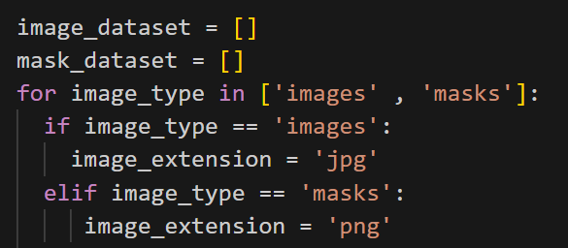

Slide 21
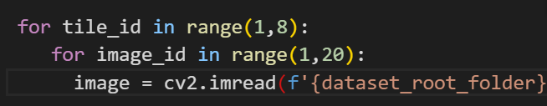
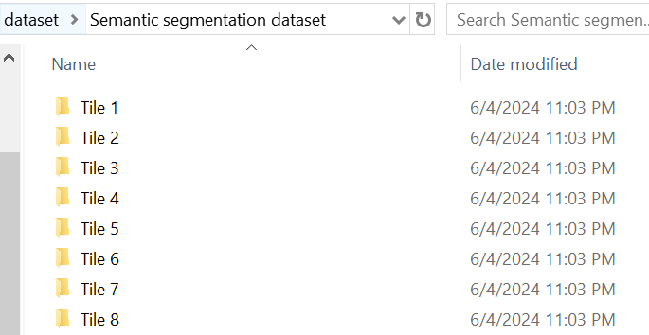

Slide 22
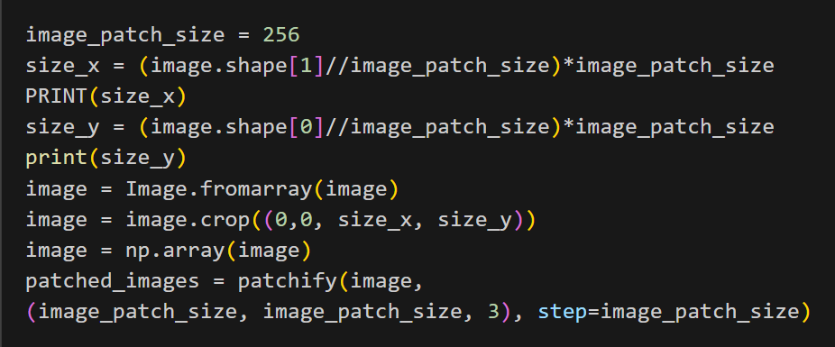

Slide 23
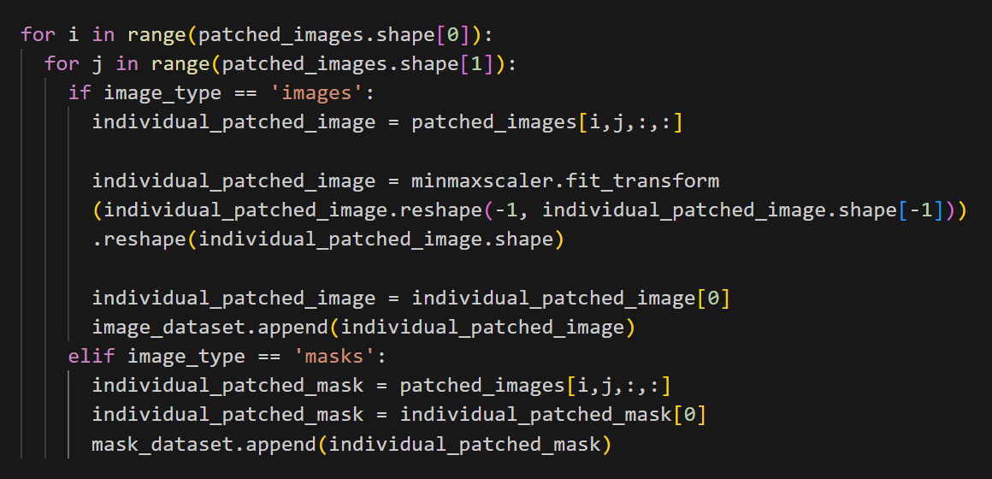

Slide 24
Personalization

Slide 25
We are also going to personalize our project by changing the class colors to brighter ones, making them more visible and easier to understand.

Slide 26
Design & Architecture

Slide 27
U-Net
Jaccard Coefficient
Loss function
One Hot Encoding

Slide 28
U-Net Implementation : Type of CNN
Encoder
BottleNeck
Decoder
Extracting features
Reduce spatial dimensions
Bridge
Has essential features
Upsampling layers
Skip Connection
Retain high-resolution features

Slide 29
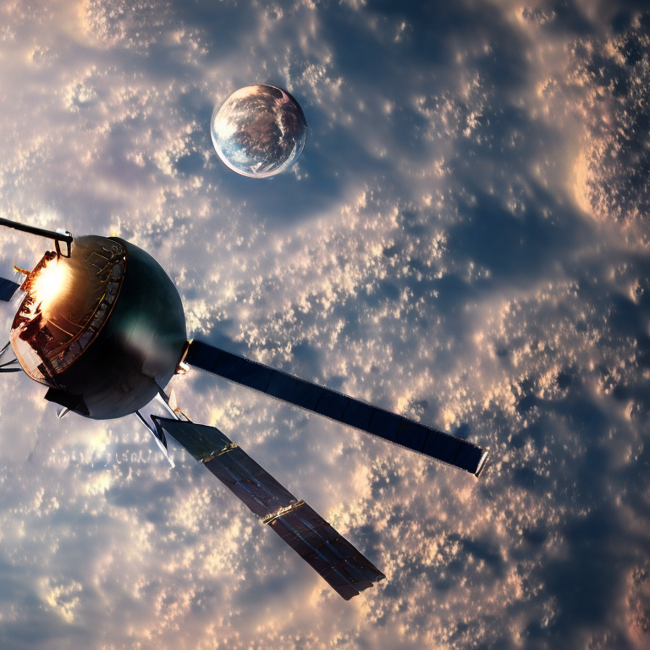

Jaccard Coefficient
Similarity between two sets
Predicted segmentation and the ground truth (actual) segmentation.
Value ranges from 0 to 1

Slide 30

Loss Function
How well or poorly the model's predictions match the ground truth
Cross-Entropy Loss
Dice Loss
Categorical Focal Loss
The optimizer adjusts the model’s weights to minimize this loss.
No overfitting & Generalized model

Slide 31

One-Hot Encooding Convert categorical data to numerical format
One-hot encoding would represent these classes as:
Road: [1, 0, 0]
Building: [0, 1, 0]
Vegetation: [0, 0, 1]

Slide 32
Testing & Training Dataset
85%
15%
Training
Testing

Slide 33
Work Flow :
Divide the dataset , apply required pre processing
Here we do prediction upon the dataset images
Normalization
Predcition
Model Compiling
Real-time Prediction
Apply the required process & layers
Take real -time images of satellite and apply model on it

Slide 34

Visual Representation of Model

Slide 35

Let’s Checkout The Model & Our App

Slide 36
Thank You!

